Slide 1
Object-Oriented System Development
Exam Preparation
Semester 1, 2019
Notes:
What will be in the exam:
Design patterns
Map, filter, reduce and lambda
SOLID principles
Django
Unit and e2e testing
Exception handling
Code smells

Slide 2
Design patterns
Abstract factory
Adapter
Builder
Command
Decorator
Observer
Simple factory
Singleton
Strategy
Template

Slide 3
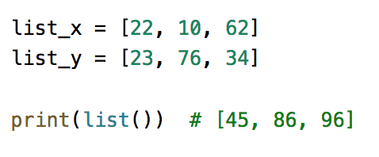
Map, filter, reduce and lambda
Simply imperative code into an expression
Write a map and lambda function that adds two list of numbers together and returns a single list of numbers

Slide 4
SOLID principles
Identify code breaking SOLID principles
Single responsibility
A class should have one, and only one, reason to change
Open-closed
You should be able to extend a class’s behavior, without modifying it
Liskov substitution
Derived classes must be substitutable for their base classes
Interface segregation
Make fine grained interfaces that are client specific
Dependency inversion
Depend on abstractions, not on concretions

Slide 5
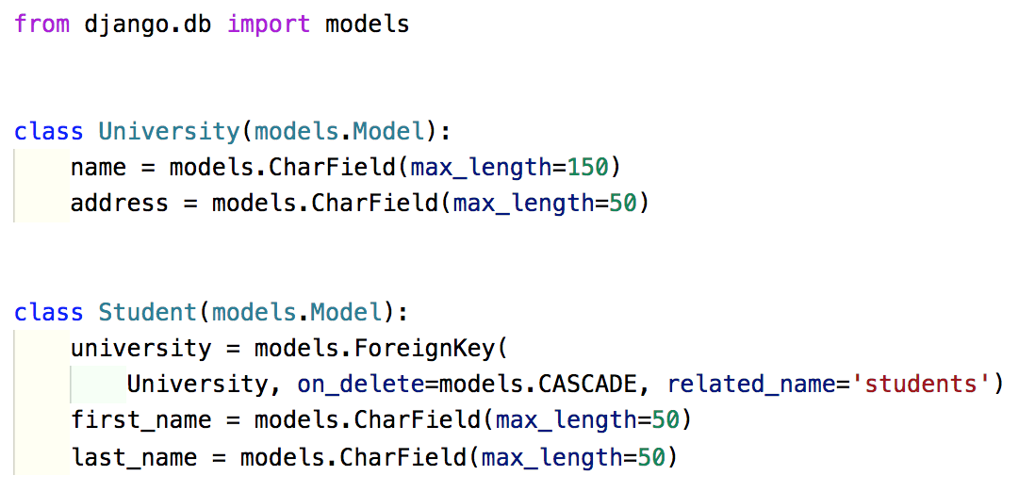
Django
Query a Django model

Slide 6
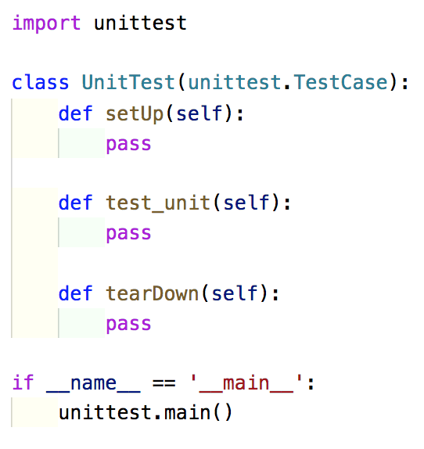
Unit and E2E Testing
Correctly setup and write a unit test and e2e test

Slide 7
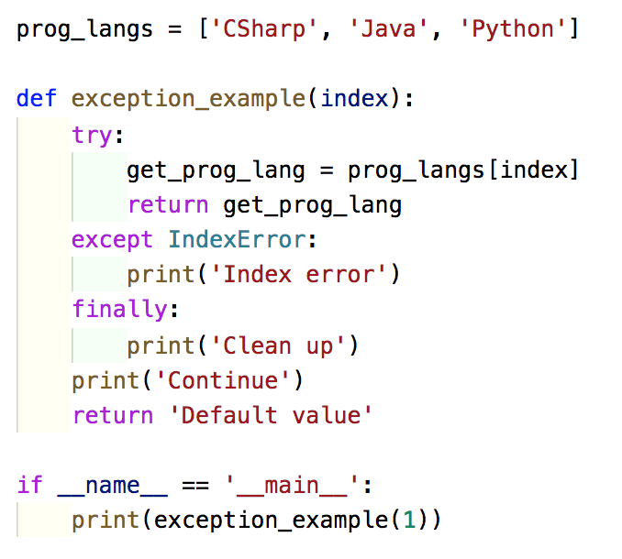
Exception handling
Try, catch and finally
What is the output?

Slide 8
Code smells
Describe common code smells discussed in class:
Contrived complexity
Large class/god object
Shotgun surgery
Boat anchoring
Cyclomatic complexity
Notes:
Contrived complexity – forced usage of overcomplicated design patterns
Large class – a class that has grown too large
Shotgun surgery – a single change needs to be applied to multiple classes at the same time
Boat-anchoring – A piece of software or hardware that serves no purpose on the current project
Cyclomatic complexity – too many branches or loops
Others to consider:
Dead code – remove commented code before you push to a version control system
Comments – often used to hide the smell. “Comments are often used as deodorants”
Excessive use of literals – should be named constants, to improve readability and maintainability
Too many parameters – a long list of parameters
Copy and pasting programming
Spaghetti code

